Slide 1
4102165: Full Stack Web Development Fundamentals
Spring 2019
簡立仁 Li-Ren Chien
ccumouse@gmail.com

Slide 2
Schedule
Today:
More custom events
this and bind() revisited
First-class functions
Next:
Asynchronous JavaScript
fetch
Promises

Slide 3

Today: Open your mind

Slide 4
Open your mind
The next few lectures are probably the most conceptually difficult in the entire quarter.
We are going to be exploring a few ways in which JavaScript is very, very different from other programming languages you know.
We will likely push on your understanding of how programming languages work!

Slide 5
But first, a review of ES6 classes

Slide 6
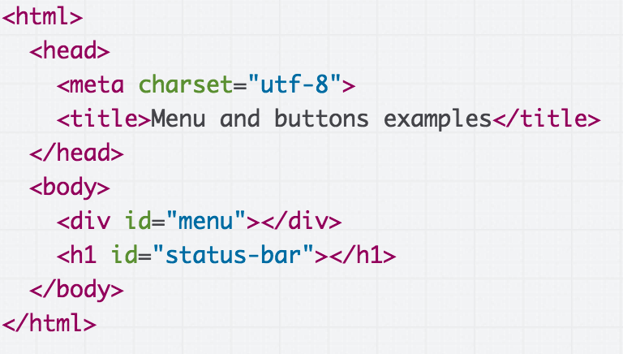
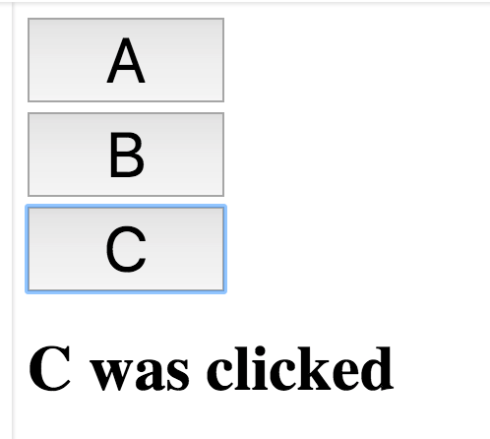
Example: Buttons
We want to:
Fill the <div id="menu"></div> with buttons A, B, and C
Update the <h1> with the button that was clicked
Live example

Slide 7
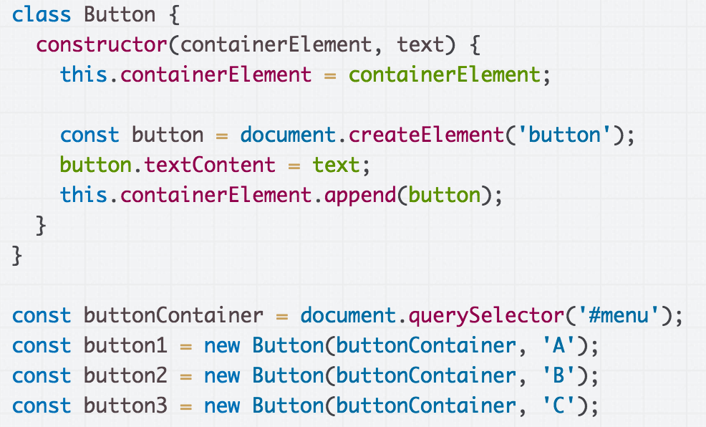
First step: Create a Button class and create three Buttons. (CodePen)

Slide 8
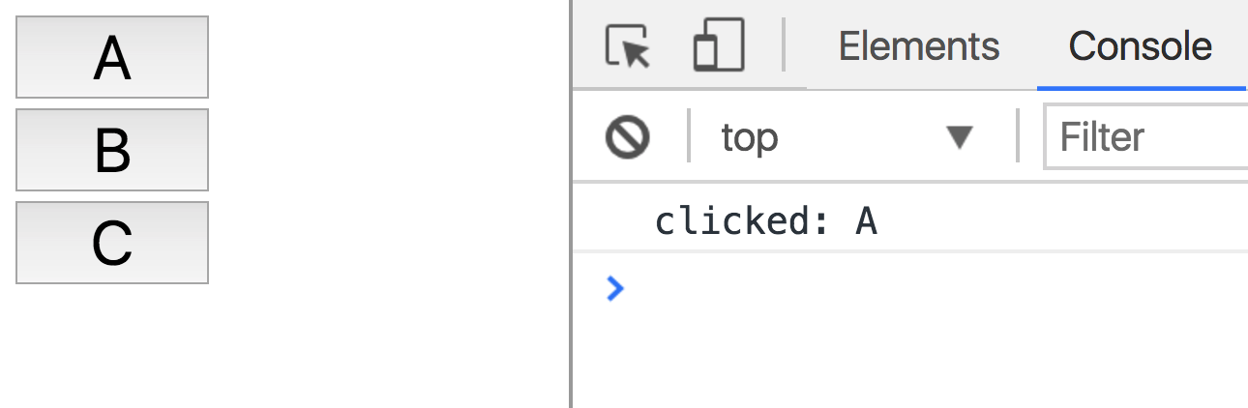
Click handler for Button
Let's make it so that every time we click a button, we print out which button was clicked in the console.
(Live)

Slide 9
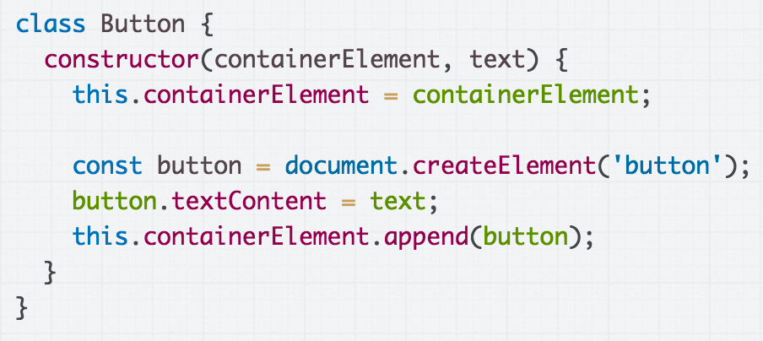
Starting with this definition of Button...

Slide 10
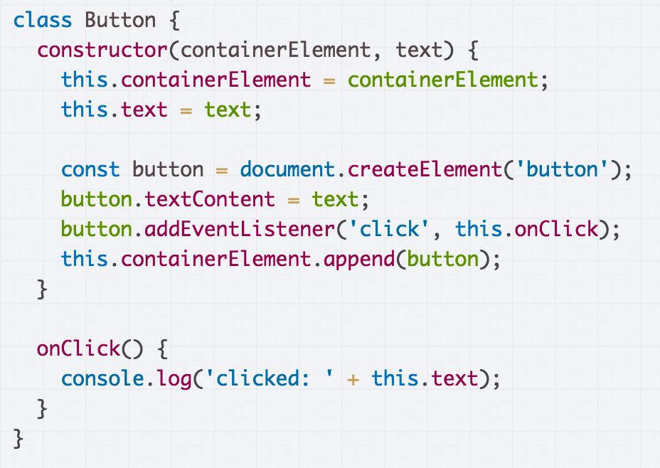
An initial attempt might look like this. (CodePen)

Slide 11
An initial attempt might look like this. (CodePen)

Slide 12
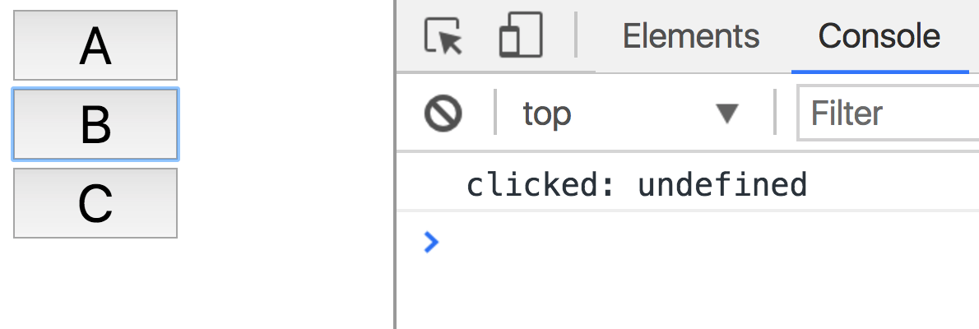
But when we run it, that gives us "clicked: undefined" (CodePen) Why?

Slide 13
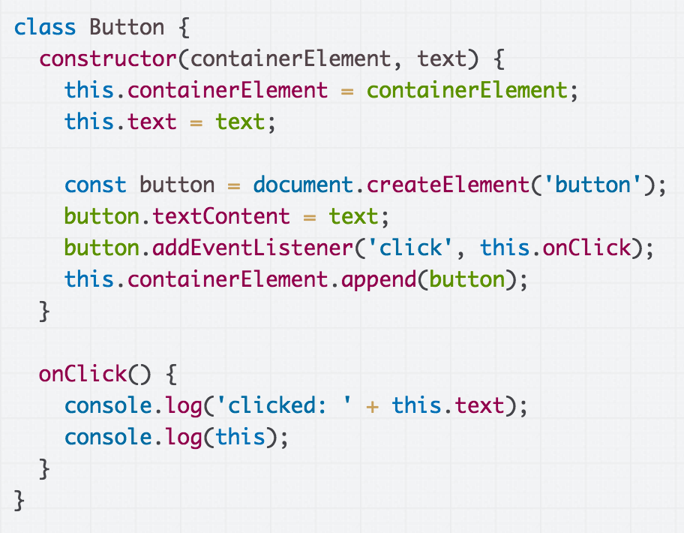
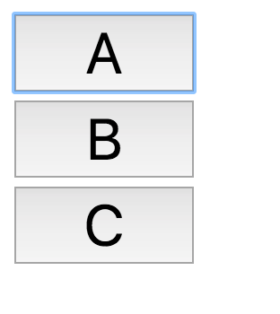
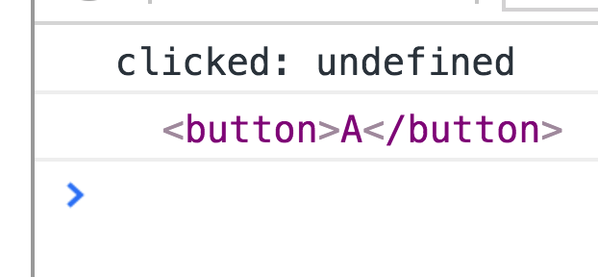
That's because the value of this in onClick is not the Button object; it is the <button> element to which we've attached the onClick event handler.

Slide 14
What?!?

Slide 15
this in JavaScript

Slide 16
this in the constructor
class Point {
constructor(x, y) {
this.x = x;
this.y = y;
}
}
In the constructor of a class, this refers to the new object that is being created.
That's the same meaning as this in Java or C++.

Slide 17
this in the constructor
// Java
public class Point {
public Point(int x, int y) {
this.x = x;
this.y = y;
}
public int x;
public int y;
}
Here's roughly the equivalent code in Java. this refers to the new object that is being created.

Slide 18
this in Java
// Java
public class Point {
...
String toString() {
return this.x + ", " + this.y;
}
}
In Java, this always refers to the new instance being created, no matter what method you're calling it from, or how that method is invoked.

Slide 19
this in JavaScript
class Point {
...
toString() {
return this.x + ", " + this.y;
}
}
But in JavaScript, this can have a different meaning if used outside of the constructor, depending on the context in which the function is called.

Slide 20
this in JavaScript
toString() {
return this.x + ", " + this.y;
}
In JavaScript, this is:
A implicit parameter that is passed to every JavaScript function, including functions not defined in a class!
The value of the this parameter changes depending on how it is called.

Slide 21
this in addEventListener
function onClick() {
console.log('Clicked!');
console.log(this);
}
const button = document.querySelector('button');
button.addEventListener('click', onClick);
When used in an event handler, this is set to the element to which that the event was added. (mdn / CodePen / live)

Slide 22
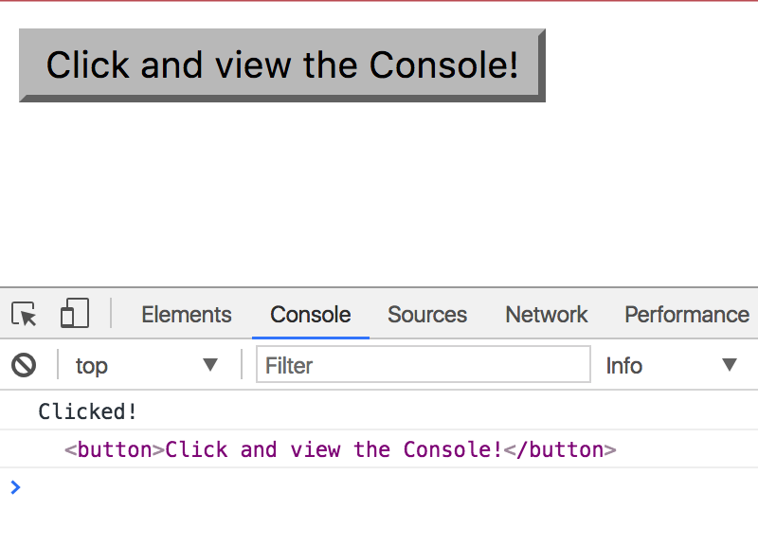
function onClick() {
console.log('Clicked!');
console.log(this);
}
const button = document.querySelector('button');
button.addEventListener('click', onClick);
In onClick, this refers to <button> because it onClick was invoked by addEventListener.

Slide 23
Let's revisit our undefined text… (CodePen)

Slide 24
In the constructor, this refers to the new object we're creating. No problems here.

Slide 25
But in onClick, this will mean something different depending on how the function is called.
That is because we are using this in a function that is not a constructor.

Slide 26
Specifically, because onClick is attached to the <button> via addEventListener...

Slide 27
...we know the value of this will be the <button> element when the click event is fired and invokes onClick.
Since HTMLButtonElement doesn't have a text property, this.text is undefined.

Slide 28
...
It'd be nice if we could set the value of "this" in onClick to be the Button object, like it is in the constructor.

Slide 29
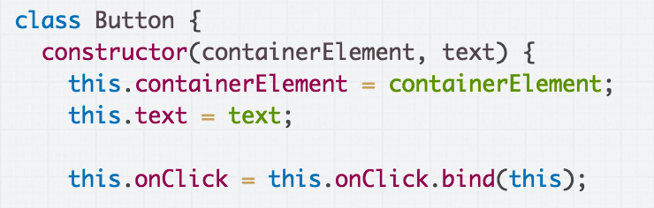
"Bind" the value of this
That is what this line of code does:
"Hey, use the current value of this in onClick"
(And the current value of this is the new object, since we're in the constructor)
CodePen / Live

Slide 30
bind in classes
constructor() {
const someValue = this;
this.methodName = this.methodName.bind(someValue);
}
This is saying:
Make a copy of methodName, which will be the exact same as methodName except this in methodName is always set to the someValue
The value of someValue is this to bind(), which is the value of the new object since we are in the constructor

Slide 31
bind in classes
constructor() {
this.methodName = this.methodName.bind(this);
}
And of course, you don't need the intermediate someValue variable.
CodePen / Live

Slide 32
One more time...

Slide 33
this in the constructor
this in the constructor refers to the new object you are creating.
constructor(x, y) {
this.x = x;
this.y = y;
}

Slide 34
this in a function
this in a function that is not a constructor has a different value, depending on how the function is called.
onClick() {
console.log(this.x);
console.log(this.u);
}
When invoked as a response to an event, the this in onClick will be Event.targetElement, or the element onto which the onClick event handler was attached.

Slide 35
A consistent this
class Point {
constructor(x, y) {
this.x = x;
this.y = y;
}
onClick() {
console.log(this.x);
console.log(this.u);
} }
Right now, this in the constructor always refers to the new object we're creating...

Slide 36
A consistent this
class Point {
constructor(x, y) {
this.x = x;
this.y = y;
}
onClick() {
console.log(this.x);
console.log(this.u);
} }
But this in onClick function refers to a different value, depending on how onClick is called.

Slide 37
A consistent this
class Point {
constructor(x, y) {
this.x = x;
this.y = y;
}
onClick() {
console.log(this.x);
console.log(this.u);
} }
It'd be nice if we could make the "this" value in onClick:
Refer to the new object we're constructing, instead of things like the dom element, etc
And make it always refer to the new object we're constructing

Slide 38
A consistent this
class Point {
constructor(x, y) {
this.x = x;
this.y = y;
this.onClick = this.onClick.bind(someParam);
}
That's what bind does:
It is saying, "Hey, in the onClick function, I want the this value to always be someParam," i.e. the value that we are passing as a parameter to bind.

Slide 39
A consistent this
class Point {
constructor(x, y) {
this.x = x;
this.y = y;
this.onClick = this.onClick.bind(someParam);
}
onClick() {
console.log(this.x);
console.log(this.u);
} }
We want the value of this in onClick to be the value of the new object being created.
In other words, we want someParam to be the value of the new object being created.

Slide 40
A consistent this
class Point {
constructor(x, y) {
this.x = x;
this.y = y;
this.onClick = this.onClick.bind(someParam);
}
onClick() {
console.log(this.x);
console.log(this.u);
} }
In the constructor, how do we access the new object being created?

Slide 41
A consistent this
class Point {
constructor(x, y) {
this.x = x;
this.y = y;
this.onClick = this.onClick.bind(this);
}
onClick() {
console.log(this.x);
console.log(this.u);
} }
In the constructor, the new object is referenced by this.
Now the this in onClick always referring to the new object.

Slide 42
What were we trying to do again?

Slide 43
Example: Buttons
We want to:
Fill the <div id="menu"></div> with buttons A, B, and C
Update the <h1> with the button that was clicked
Live example

Slide 44
(Contrived) OO example
For practice, we'll write this using 2 classes:
Menu:
Has an array of Buttons
Also updates the <h1> with what was clicked
Button:
Notifies Menu when clicked, so that Menu can update the <h1>
Menu
Has a list of Buttons
Present
Present
Button

Slide 45
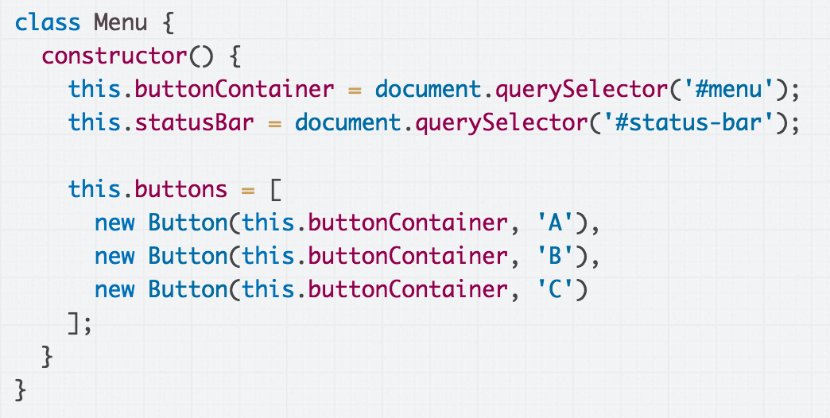
Partial solution: We create a Menu class, which creates the Buttons (CodePen)

Slide 46

Then we create the Menu (and the menu creates the Buttons) when the page loads. (CodePen)

Slide 47
Update Menu when Button clicked
Our current Menu doesn't do much.

Slide 48
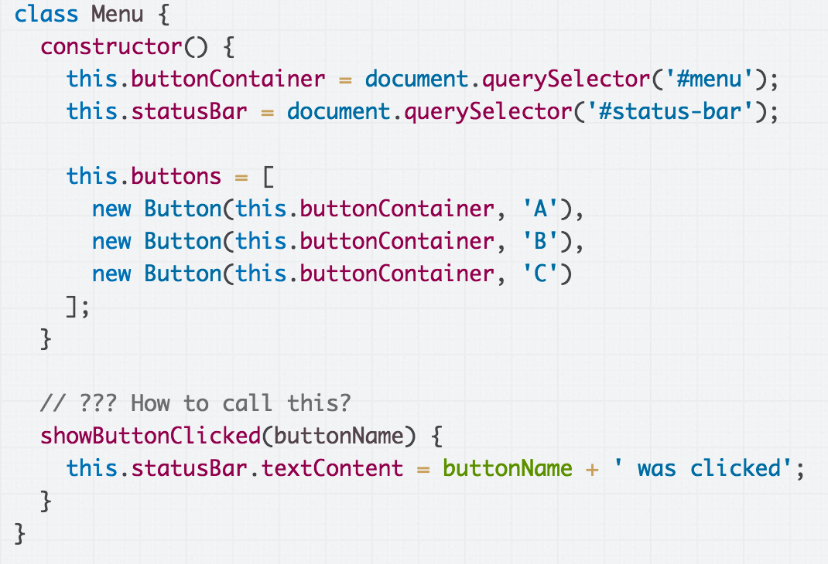
Update Menu when Button clicked
We want the Menu to update the <h1> when one of the Buttons are clicked. How do we do this?

Slide 49
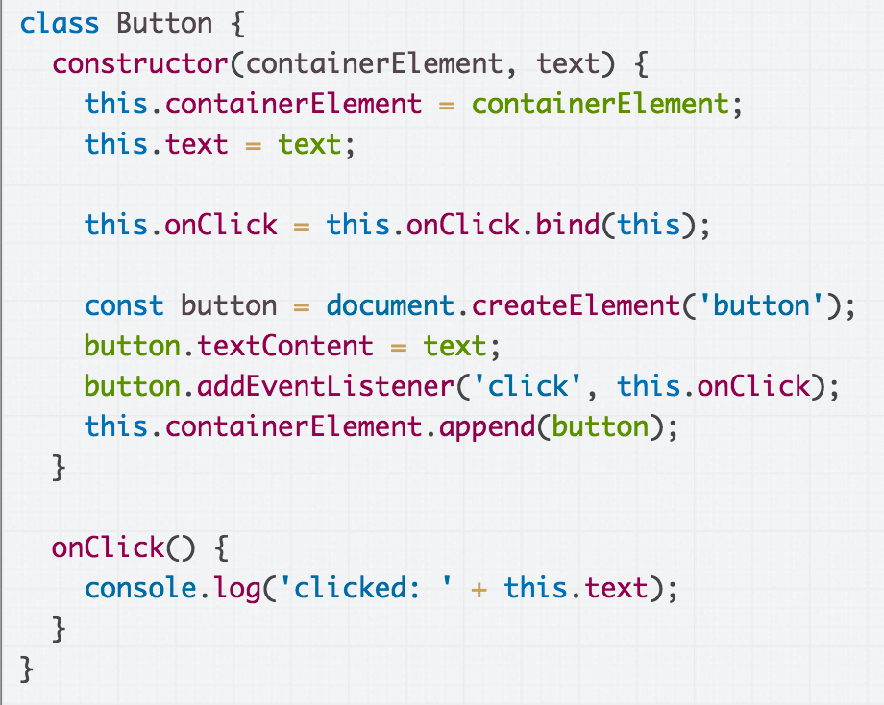
Communicating upstream
Menu
Has a reference to
Button
Button is the thing that knows it was clicked...

Slide 50
Communicating upstream
Menu
Has a reference to
Button
But Menu is the thing that can update the header.

Slide 51
Communicating upstream
Menu
"I was clicked!"
Has a reference to
Button
It needs to be possible for a Button to tell the Menu that it has been clicked.

Slide 52
One strategy for doing this: Custom events

Slide 53
Custom Events
You can listen to and dispatch Custom Events to communicate between classes (mdn):
const event = new CustomEvent( eventNameString, optionalParameterObject);
element.addEventListener(eventNameString, functionName);
element.dispatchEvent(eventNameString);

Slide 54
Custom Events on document
CustomEvent can only be listened to / dispatched on HTML elements, and not on arbitrary class instances.
Therefore we are going to be adding/dispatching events on the document object, so that events can be globally listened to/dispatched.
document.addEventListener(eventNameString, functionName);
document.dispatchEvent(eventNameString);

Slide 55
Define a custom event
We'll define a custom event called 'button-click':
Menu will listen for the event:
document.addEventListener(
'button-click', this.showButtonClicked);
Button will dispatch the event:
document.dispatchEvent(
new CustomEvent('button-click'));

Slide 56
A first attempt: We should listen for the custom 'button-click' event in Menu.

Slide 57
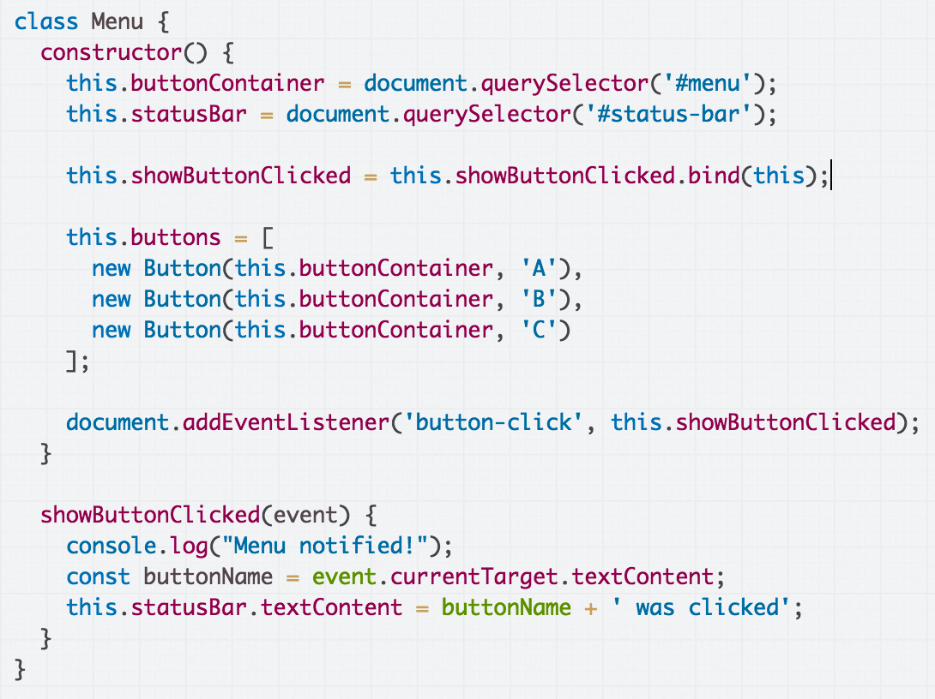
A first attempt: Listen for the custom 'button-click' event in Menu. Note the call to bind! (CodePen)

Slide 58
A first attempt: Listen for the custom 'button-click' event in Menu. Note the call to bind! (CodePen)

Slide 59
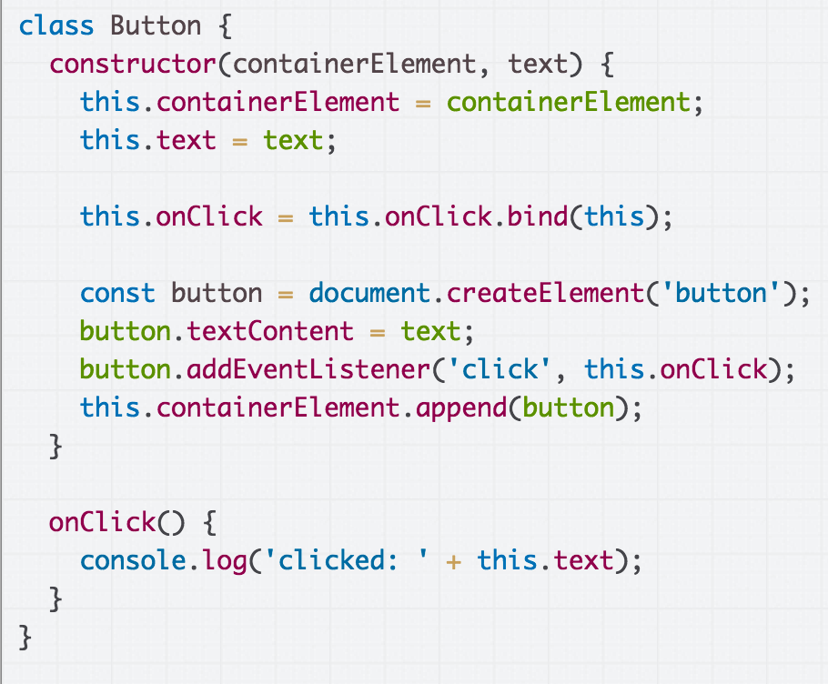
Then we want to dispatch the 'button-click' event in the onClick event handler in Button.

Slide 60
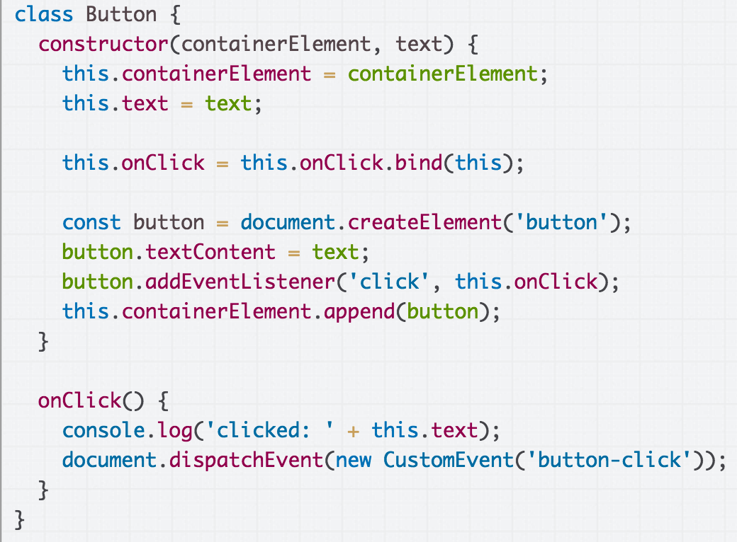
Dispatch the 'button-click' event in the onClick event handler in Button (CodePen).

Slide 61
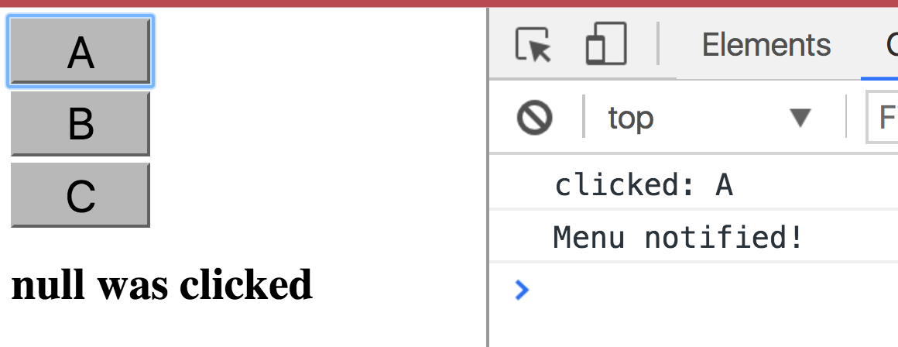
When we try it out, the event dispatching seems to work… but our output is "null was clicked"
(CodePen / Live)

Slide 62
The problem is we are adding custom event listeners to document, meaning event.currentTarget is going to be document, and not <button>

Slide 63
Communicating upstream
Menu
"Button B was clicked!"
Has a reference to
Button
Menu knows some button was clicked… How do we tell the Menu which button was clicked?

Slide 64
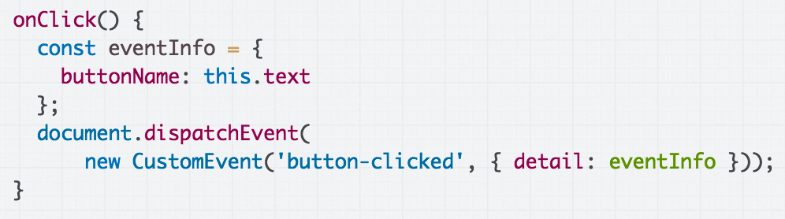
CustomEvent parameters
You can add a parameter to your CustomEvent:
Create an object with a detail property
The value of this detail property can be whatever you'd like.

Slide 65
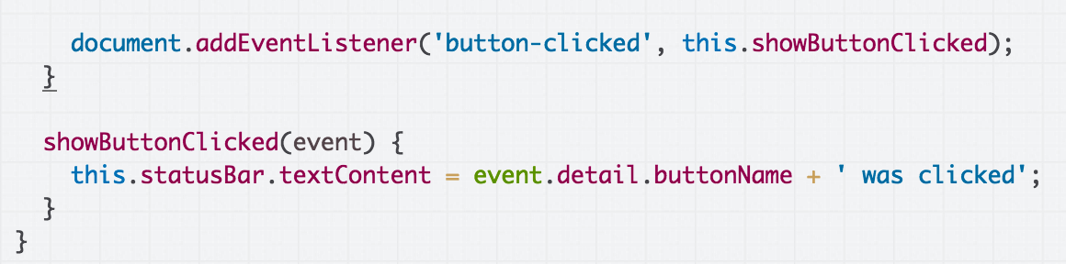
CustomEvent parameters
You can add a parameter to your CustomEvent:
The event handler for your CustomEvent will be able to access this detail property via Event.detail
Finished CodePen

Slide 66
First-class functions

Slide 67
Recall: addEventListener
Over the last few weeks, we've been using functions as a parameter to addEventListener:
dragon.addEventListener(
'pointerdown', onDragStart);
image.addEventListener(
'click', this._openPresent);
Q: How does this actually work?

Slide 68
First-class functions
Functions in JavaScript are objects.
They can be saved in variables
They can be passed as parameters
They have properties, like other objects
They can be defined without an identifier
(This is also called having first-class functions, i.e. functions in JavaScript are "first-class" because they are treated like any other variable/object.)

Slide 69
First-class functions
Functions in JavaScript are objects.
They can be saved in variables
They can be passed as parameters
They have properties, like other objects
They can be defined without an identifier
(This is also called having first-class functions, i.e. functions in JavaScript are "first-class" because they are treated like any other variable/object.)
???

Slide 70
First-class functions
Functions in JavaScript are objects.
They can be saved in variables
They can be passed as parameters
They have properties, like other objects
They can be defined without an identifier
(This is also called having first-class functions, i.e. functions in JavaScript are "first-class" because they are treated like any other variable/object.)
Isn't there like… a fundamental difference between "code" and "data"?
???

Slide 71
Be prepared to let go of some assumptions you had about programming languages.

Slide 72
Let's take it all the way back to first principles...

Slide 73
Back to the veeeeery basics
What is code?
A list of instructions your computer can execute
Each line of code is a statement
What is a function?
A labeled group of statements
The statements in a function are executed when the function is invoked
What is a variable?
A labeled piece of data

Slide 74
Recall: Objects in JS
Objects in JavaScript are sets of property-value pairs:
const bear = { name: 'Ice Bear',
hobbies: ['knitting', 'cooking', 'dancing'] };
Like any other value, Objects can be saved in variables.
Objects can be passed as parameters to functions

Slide 75
Back to the veeeeery basics
What is code?
A list of instructions your computer can execute
Each line of code is a statement
What is a function?
A labeled group of statements
The statements in a function are executed when the function is invoked
What is a variable?
A labeled piece of data
What could it mean for a function to be an object, i.e. a kind of data?

Slide 76
Function variables
You can declare a function in several ways:
function myFunction(params) {
}
const myFunction = function(params) {
};
const myFunction = (params) => {
};

Slide 77
Function variables
function myFunction(params) {
}
const myFunction = function(params) {
};
const myFunction = (params) => {
};
Functions are invoked in the same way, regardless of how they were declared:
myFunction();

Slide 78
const x = 15;
let y = true;
const greeting = function() {
console.log('hello, world');
}
"A function in JavaScript is an object of type Function"

Slide 79
In the interpreter's memory:
const x = 15;
let y = true;
const greeting = function() {
console.log('hello, world');
}
"A function in JavaScript is an object of type Function"

Slide 80
In the interpreter's memory:
x
15
const x = 15;
let y = true;
const greeting = function() {
console.log('hello, world');
}
"A function in JavaScript is an object of type Function"

Slide 81
In the interpreter's memory:
x
15
const x = 15;
let y = true;
const greeting = function() {
console.log('hello, world');
}
y
true
"A function in JavaScript is an object of type Function"

Slide 82
In the interpreter's memory:
x
15
const x = 15;
let y = true;
const greeting = function() {
console.log('hello, world');
}
y
true
greeting
...
"A function in JavaScript is an object of type Function"
What this really means:
When you declare a function, there is an object of type Function that gets created alongside the labeled block of executable code.

Slide 83
Function properties
const greeting = function() {
console.log('hello, world');
}
console.log(greeting.name);
console.log(greeting.toString());
When you declare a function, you create an object of type Function, which has properties like:
name
toString
CodePen

Slide 84
Function properties
const greeting = function() {
console.log('hello, world');
}
greeting.call();
Function objects also have a call method, which invokes the underlying executable code associated with this function object.
CodePen

Slide 85
Function properties
const greeting = function() {
console.log('hello, world');
}
greeting.call();
greeting();
() is an operation on the Function object (spec)
When you use the () operator on a Function object, it is calling the object's call() method, which in turn executes the function's underlying code

Slide 86
Code vs Functions
Important distinction:
Function, the executable code
A group of instructions to the computer
Function, the object
A JavaScript object, i.e. a set of property-value pairs
Function objects have executable code associated with them
This executable code can be invoked by
functionName(); or
functionName.call();

Slide 87
Note: Function is special
Only Function objects have executable code associated with them.
Regular JS objects cannot be invoked
Regular JS objects cannot be given executable code
I.e. you can't make a regular JS object into a callable function
const bear = { name: 'Ice Bear',
hobbies: ['knitting', 'cooking', 'dancing'] };
bear(); // error!

Slide 88
Function Objects vs Objects
function sayHello() {
console.log('Ice Bear says hello');
}
const bear = { name: 'Ice Bear',
hobbies: ['knitting', 'cooking', 'dancing'],
greeting: sayHello };
bear.greeting();
CodePen
But you can give your object Function properties and then invoke those properties.

Slide 89
Function Objects vs Objects
function sayHello() {
console.log('Ice Bear says hello');
}
const bear = { name: 'Ice Bear',
hobbies: ['knitting', 'cooking', 'dancing'],
greeting: sayHello };
bear.greeting();
CodePen
The greeting property is an object of Function type.

Slide 90
Why do we have Function objects?!

Slide 91
Callbacks
Function objects really come in handy for event-driven programming!
function onDragStart(event) {
...
}
dragon.addEventListener('pointerdown', onDragStart);
Because every function declaration creates a Function object, we can pass Functions as parameters to other functions.

Slide 92
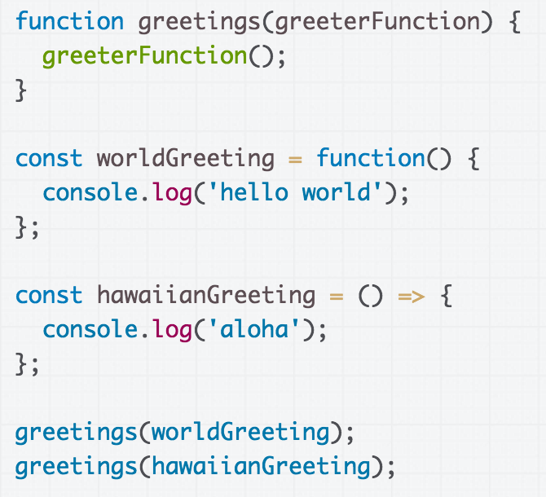
Simple, contrived example
CodePen

Slide 93
This example is really contrived!
Aside from addEventListener, when would you ever want to pass a Function as a parameter?
CodePen

Slide 94
A real example: Callbacks
Another way we can communicate between classes is through callback functions:
Callback: A function that's passed as a parameter to another function, usually in response to something.

Slide 95
Callback: Present example
Let's have Presents communicate with App via callback parameter: (CodePen attempt)
App has _onPresentOpened method
When App is constructing Presents, pass its this._onPresentOpened method as parameter to Present constructor
App
Has a list of Presents
Present
Present
Present
Each Present saves an onOpenCallback parameter in the constructor
When the present is opened, fire the callback
Present
Present

Slide 96
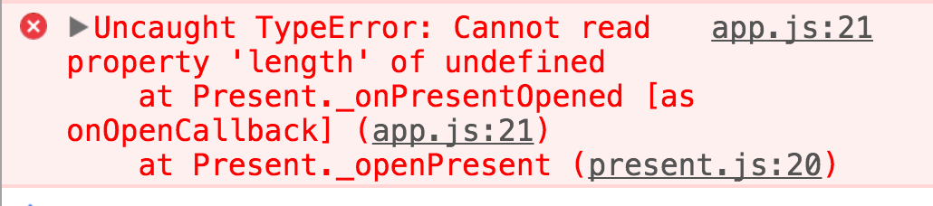
this in event handler
Say, it's another error in our event handler...

Slide 97
this in a method: Next time!

Slide 98
Overflow slides

Slide 99
this in a method
function sayHello() {
console.log(this.name + ' says hello');
}
const bear = { name: 'Ice Bear',
hobbies: ['knitting', 'cooking', 'dancing'],
greeting: sayHello };
bear.greeting();
CodePen
When we use this in a function that is not being invoked by an event handler, this is set to the object on which the method is called.

Slide 100
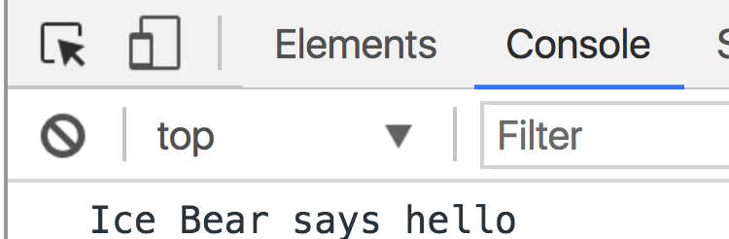
this in a method
function sayHello() {
console.log(this.name + ' says hello');
}
const bear = { name: 'Ice Bear',
hobbies: ['knitting', 'cooking', 'dancing'],
greeting: sayHello };
bear.greeting();

Slide 101
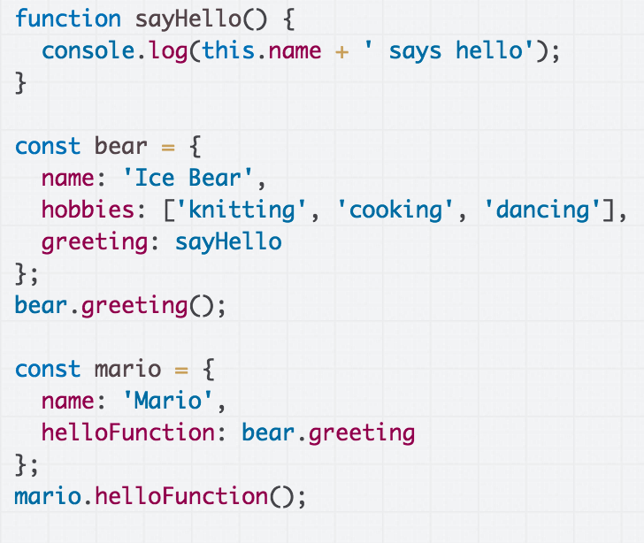
What is the output of the code above?
(CodePen)

Slide 102
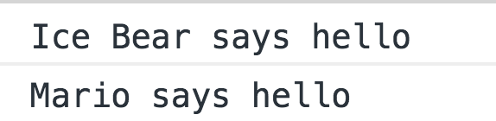

Slide 103
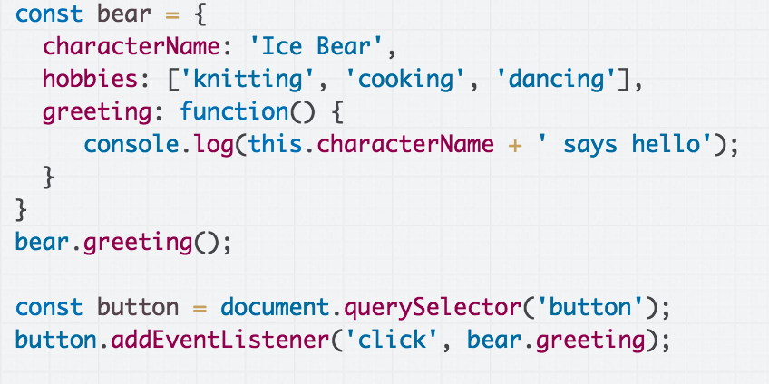


What is the output of the code above, if we click the button?
(CodePen)

Slide 104
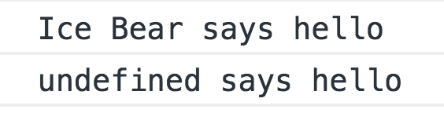

Slide 105
When called as a method, the value of this is the object on which the method was called.

Slide 106
But when called from an event handler, this is the DOM object to which the event was attached.
Since <button> doesn't have a characterName property, we see "undefined says hello"

Slide 107
bind, revisited
this is a parameter to passed to every function in JavaScript.
JavaScript assigns this to be a different value depending on how it is used.
When called as a method, this is the object on which the method was called
When called from an event handler, this is the DOM element on which the event handler was attached

Slide 108
bind, revisited
someFunction.bind(valueOfThis);
The bind() method:
Returns a new function that is a copy of someFunction
But in this new function, this is always set to valueOfThis, no matter how the function is invoked

Slide 109
bind in classes
constructor() {
const someValue = this;
this.methodName = this.methodName.bind(someValue);
}
This is saying:
Make a copy of methodName, which will be the exact same as methodName except this in methodName is always set to the someValue
The value of someValue is this to bind(), which is the value of the new object since we are in the constructor

Slide 110
bind in classes
constructor() {
this.methodName = this.methodName.bind(this);
}
And of course, you don't need the intermediate someValue variable.

Slide 111
Callback: Present example
We can fix this error message by binding the method:
CodePen solution

